Slide 1
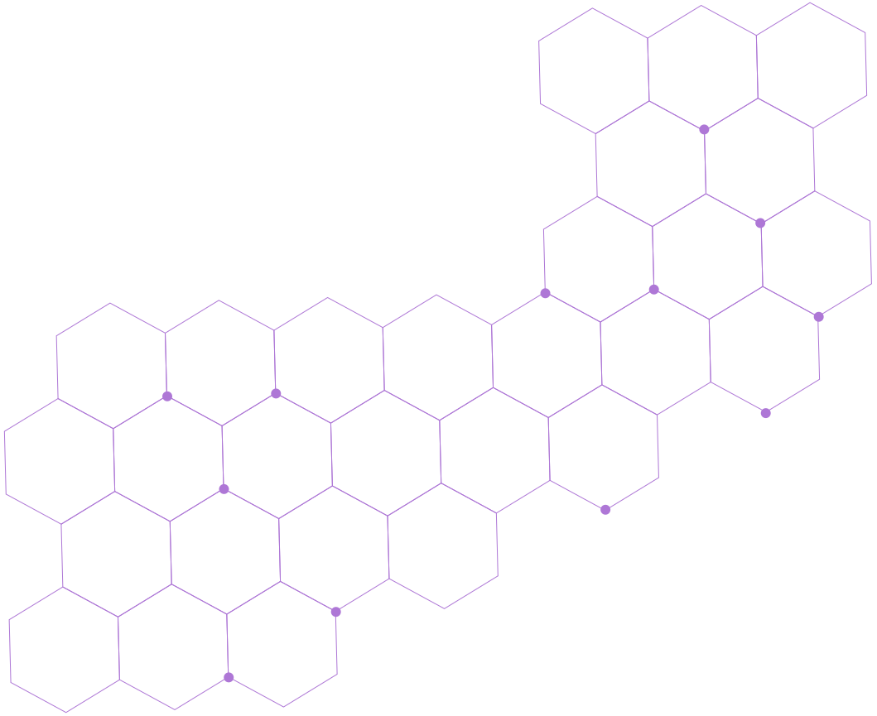
Automated Detection of Osteoporosis and Osteopenia in Elderly Patients using Knee X-ray Image Analysis
Gaurav Bhaumik - 21BCE1495
Sargam Chaudhary - 21BCE5624
Shashank Agarwal - 21BCE1586
Team Number - 937
Faculty Guide:
Dr. Deepa Nivethika S

Slide 2
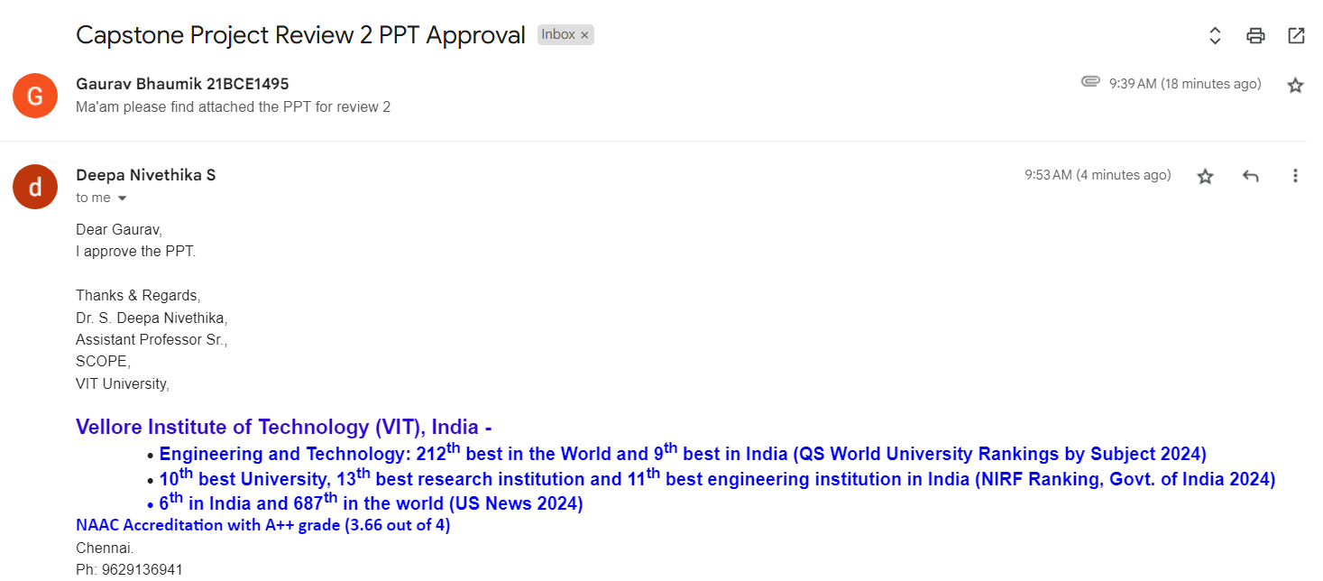
Guide Approval

Slide 3
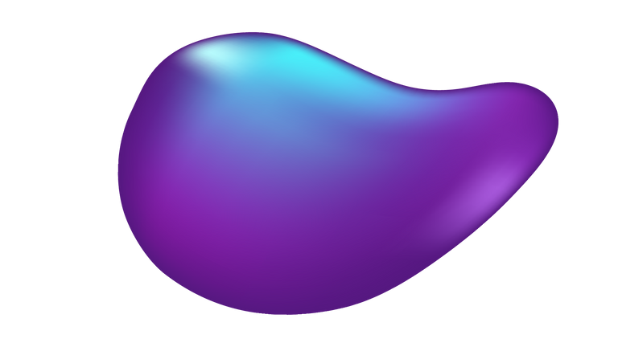
Introduction
Osteoporosis, a disease, which often goes undiagnosed until fractures occur, causing pain, disability, and reduced independence in elderly patients. Early detection is crucial for effective management and fracture risk reduction, but current methods are time-consuming. This project presents a novel approach using transfer learning with convolutional neural networks (CNNs) for osteoporosis detection from X-ray images. The approach achieves high accuracy in diagnosis and provides a revealed feature map for medical professionals. The innovation involves a dual strategy: integrating transfer learning from CNN architectures and a dataset collection augmentation mechanism. The study uses 1947 knee X-rays for training and testing.

Slide 4
These findings highlight the potential of deep learning with transfer learning in aiding early osteoporosis detection and mitigating fracture risks.
Brief overview of the project:
Model architecture: We will investigate various deep learning models of convolutional neural networks utilizing transfer learning approach to ensure detection accuracy and efficiency, including VGG-19, Custom CNN, ResNet-50, DenseNet-121, EfficientNet and XceptionNet for accurate knee osteoporosis detection.

Slide 5
2. The detection aim is binary classes for osteoporosis detection and multiclass for osteoporosis and osteopenia detection. As such, our work serves both directions.
3. Dataset Use: The model is trained and evaluated on an assembled dataset , which is a combination of four independent datasets. Furthermore, after combining the datasets, data augmentation is employed to solve the unbalanced dataset problem

Slide 6
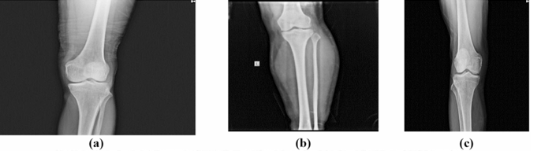
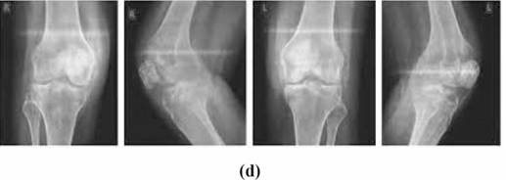
X-ray images for (a) normal, (b) osteopenia, (c) osteoporosis knee, (d) noticed change in bone density, and detailed measures of knee densities

Slide 7
Problem Statement
Osteoporosis, a silent disease, often goes undiagnosed until fractures occur, causing pain, disability, and reduced independence in elderly patients. Early detection is critical for managing bone loss and preventing fractures, but existing diagnostic methods are time-consuming and not widely accessible.
This project proposes an automated detection system for osteoporosis and osteopenia using deep learning models, leveraging convolutional neural networks (CNNs) and transfer learning. By analyzing knee X-ray images, the system classifies conditions into normal, osteopenia, and osteoporosis categories, achieving high diagnostic accuracy.

Slide 8
Significance of Knee Osteoporosis Diagnosis
Accurate measurements of bone density in the knee are crucial for reducing serious consequences. Dual-energy X-ray absorptiometry (DXA) examinations or whole leg models are ineffective for estimating knee mineral density, as BMD over the entire knee area is not of direct clinical significance. In clinical practice, diagnosis of knee osteoarthritis is mainly based on X-ray radiographs. There is a demand for a rapid, non-invasive, and accurate diagnostic tool for knee osteoarthritis.
Osteoporosis is a bone disease characterized by decreased bone density and strength, making bones fragile and more prone to fractures. It occurs when bone loss outpaces bone formation, leading to porous and brittle bones.

Slide 9
Common in older adults, especially postmenopausal women, osteoporosis increases the risk of fractures in areas like the hip, spine, and wrist. Factors such as aging, hormonal changes, calcium deficiency, and lack of physical activity contribute to its development.
Challenges such as knee degeneration, delayed treatment, increased post-fracture hospitalization duration, and major depressive disorder secondary to femoral neck fractures are common, particularly in elderly women. The study aims to develop a rapid diagnostic tool for early detection and support decision-making in clinical practice.

Slide 10
Research Objectives
Develop a Robust Diagnostic Model: Design and implement a deep learning model using CNNs and transfer learning to classify knee X-rays into normal, osteopenia, and osteoporosis categories with high accuracy.
Enable Early Detection with Increased Accuracy: Facilitate early diagnosis of osteoporosis to reduce the risk of fractures and improve patient outcomes.
Address Data Challenges: Overcome limitations of small and imbalanced datasets through augmentation and integration of multiple datasets for improved model reliability.
Advance Medical Imaging: Enhance the application of AI in healthcare by creating an efficient, scalable, and clinically viable tool for knee osteoporosis detection.

Slide 11
Methodology
Convolutional Neural Networks (CNNs) Models:
Convolutional Neural Networks (CNNs) consist of three primary layers: convolutional, pooling, and fully connected. The convolutional layer extracts features from input images, while pooling reduces spatial dimensionality. Stacking multiple layers allows for higher-level feature maps extraction. Transfer learning in deep learning involves feature extraction and fine-tuning.
Feature extraction removes the top classification layer, while fine-tuning uses pre-trained model weights to adapt general features to specific ones. This study employed pre-trained weights from ImageNet and implemented a transfer learning strategy to mitigate overfitting due to limited training data.

Slide 12
Normalization:
Normalization is a crucial step in preparing images for deep learning models. It involves adjusting the pixel intensity values to a consistent range, such as [0, 1] or [-1, 1]. This ensures that features are on the same scale, preventing any single feature from dominating the learning process. Common normalization techniques include Min-Max scaling, where pixel values are scaled to the range [0, 1], and standardization, which transforms values to have a mean of 0 and a standard deviation of 1.
Resizing:
Resizing ensures that all images in a dataset are of uniform dimensions, which is a requirement for most deep learning models. Resizing can be done by scaling the image while maintaining its aspect ratio or by cropping and padding to achieve the desired size. Proper resizing preserves the essential features in the image while aligning the input data to the model's architecture. This step is vital for consistent performance and computational efficiency.

Slide 13
Feature Extraction:
Our models use pre-trained convolutional layers to extract key features from images, creating feature maps that capture visual patterns. Activation functions and max pooling enhance and reduce these features, allowing them to be used for tasks like image classification. This approach leverages learned knowledge from a large dataset to extract meaningful features effectively.
Classification:
The classification process in our models involves extracting features from an input image to assign a label or category. The output is flattened into a vector and passed through a classifier, which makes predictions based on the extracted features. The classifier consists of dense layers and a SoftMax activation function, which adjust weights during training to map extracted features to specific classes. During inference or testing, the input image is passed through the feature extraction layers, and the output of the SoftMax layer represents the probabilities of each class.

Slide 14
Plan of Solution:
Our ongoing research is focused on the creation of an advanced algorithm tailored for osteoporosis diagnosis, relying on a sophisticated blend of neural network architectures. These include renowned models such as VGG-16, ResNet, VGG-19, CNN, EfficientNet, DenseNet and XceptionNet. This comprehensive integration of diverse architectures underscores our commitment to elevating the accuracy and efficacy of osteoporosis detection. By harnessing the capabilities of these cutting-edge models, we aim to not only enhance diagnostic precision but also contribute significantly to the evolution of methodologies in medical image analysis.

Slide 15
Dataset
The study uses a multiclass dataset consisting of four datasets for training deep learning models. The dataset includes 793 images for osteoporosis, 374 for osteopenia, and 780 for healthy patients. Two levels of data augmentation are used: the first to increase the number of images in the osteopenia class category, and the second to increase the dataset's size to accommodate the deep learning models' learning process

Slide 16
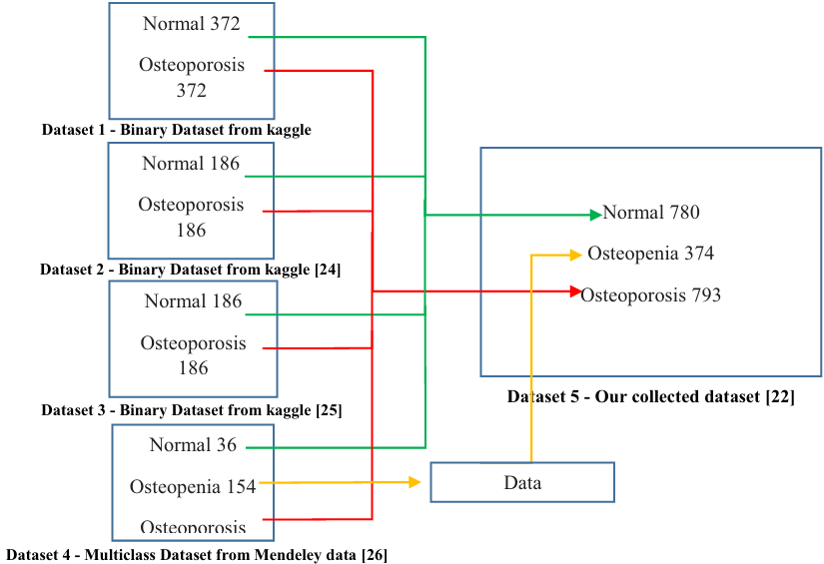

Slide 17
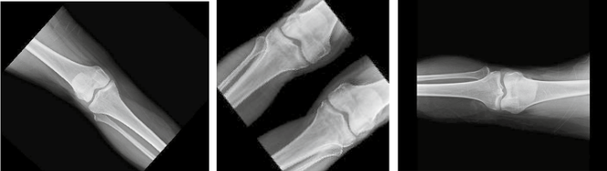
Dataset images augmentation using flipping, scaling, and rotation functions
These transformations, when applied individually or in combination, contribute to the creation of a more diverse training dataset.

Slide 18
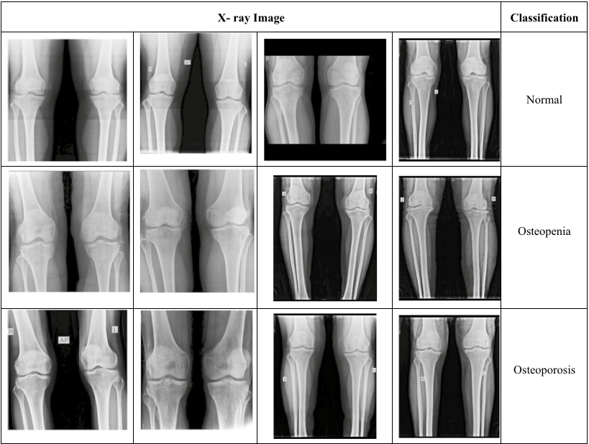

Slide 19
Comparitive Analysis

Slide 20
Custom CNN for Multiclass Model:
A custom CNN is a network architecture designed to solve specific tasks or problems. It involves choosing the right number and type of layers based on input data characteristics and task objectives. The proposed model is a deep convolutional neural network (CNN) for image classification, consisting of 13 convolutional layers, 4 max pooling layers, and 3 fully connected layers. Batch normalization is applied after each layer, and the output layer has 3 units with softmax activation.

Slide 21
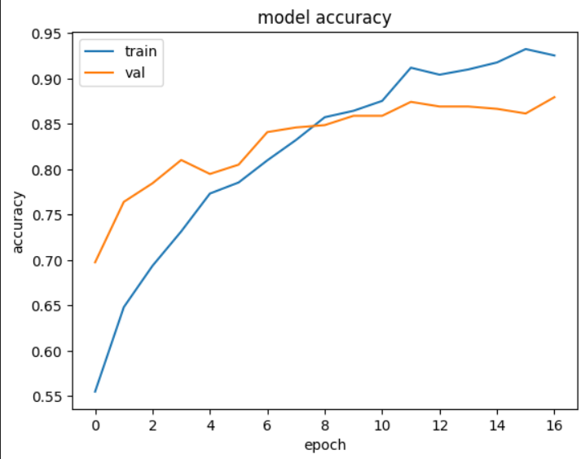
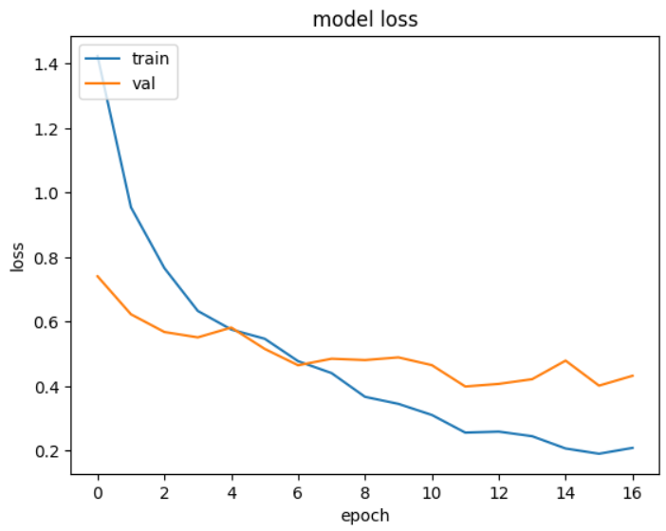
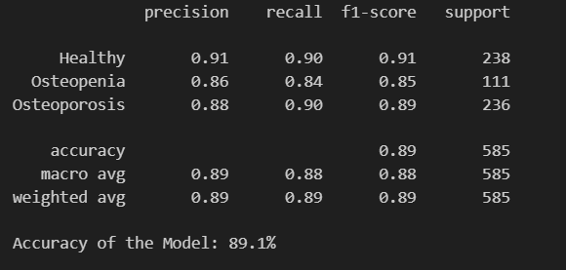

Slide 22
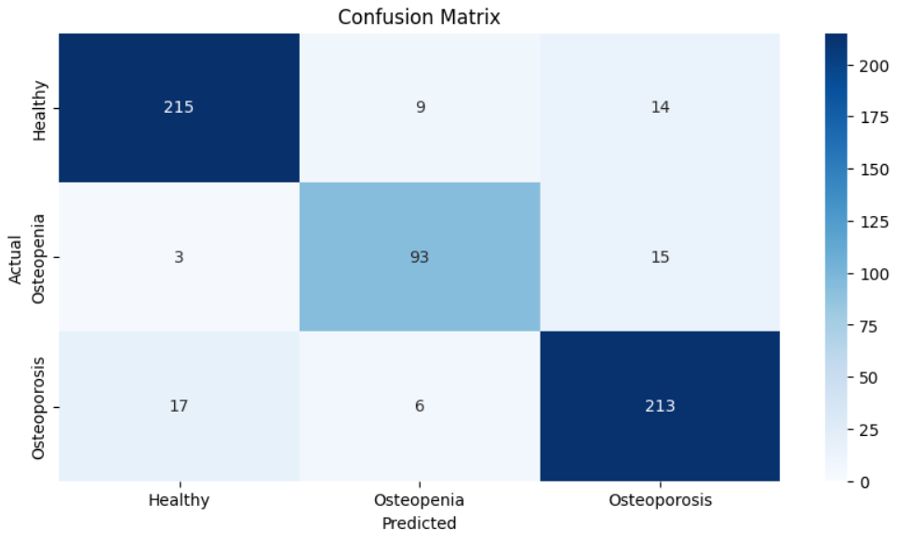

Slide 23
VGG19 for Binary Model:
VGG19 is a deep convolutional neural network with 19 layers, designed for image classification and feature extraction tasks. It uses a stack of small 3x3 convolutional filters, combined with max-pooling layers, to progressively capture spatial hierarchies. The model ends with fully connected layers and softmax for classification. Known for its simplicity and effectiveness, VGG19 is widely used in transfer learning

Slide 24
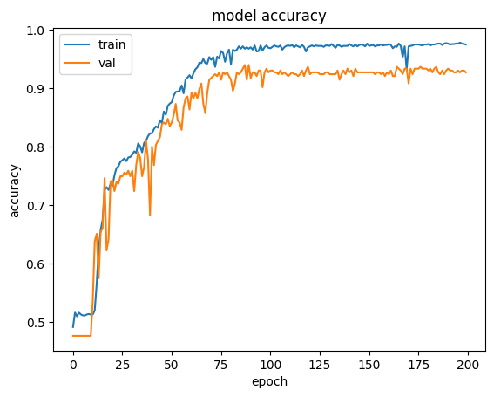
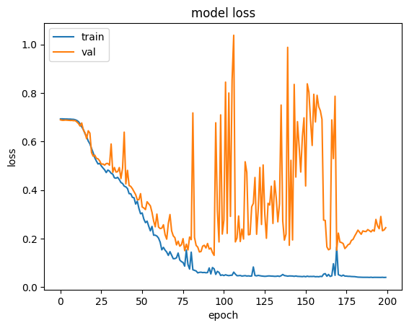
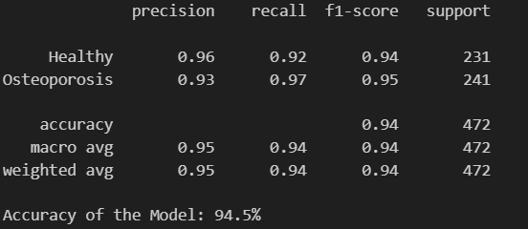

Slide 25
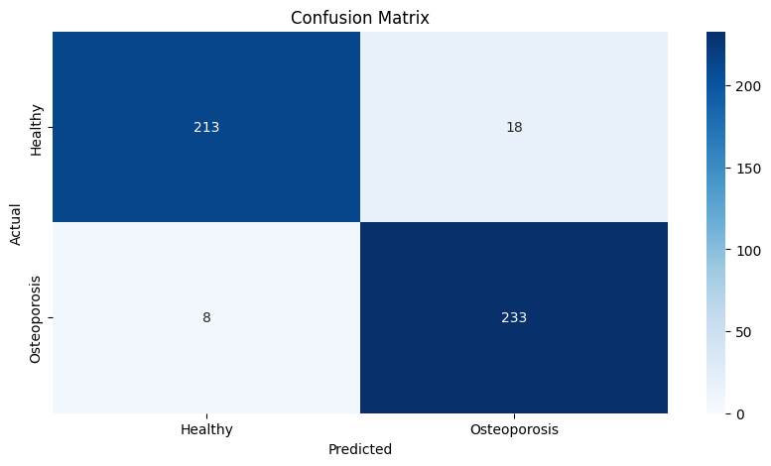

Slide 26
ResNet-50 for Binary Model:
ResNet-50 represents a convolutional neural network characterized by its depth of 50 layers. It allows for the loading of a pre-trained version, having been trained on an extensive dataset comprising over a million images sourced from the ImageNet database. It uses residual connections, allowing the input to skip layers and be added to the output of later layers, enabling more efficient learning and faster convergence.

Slide 27
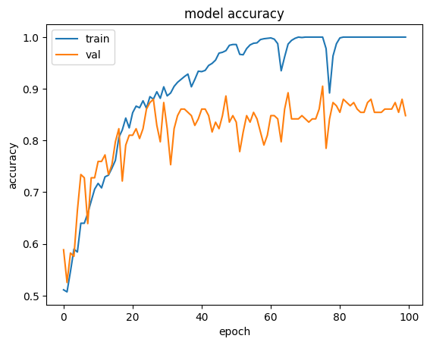
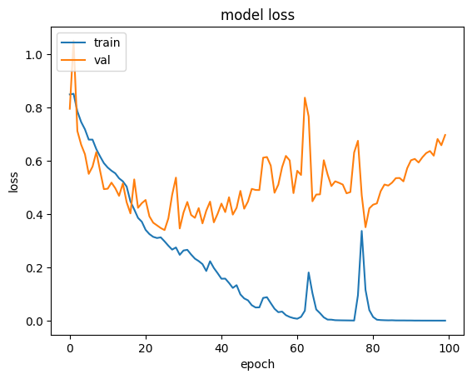
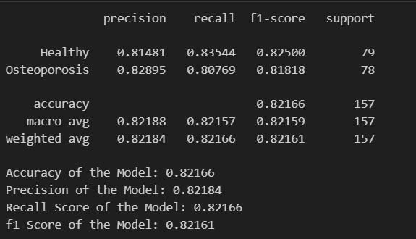

Slide 28
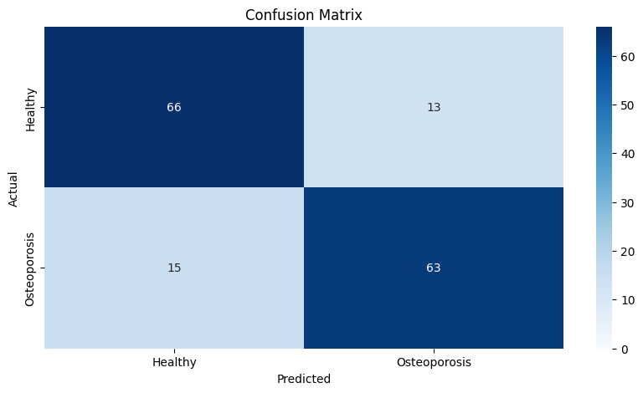

Slide 29
DenseNet-121 for Binary Model:
DenseNet-121 is a deep convolutional neural network with 121 layers, designed for efficient feature reuse and gradient flow. Unlike traditional architectures, each layer in DenseNet connects to every other layer, ensuring maximum information flow and reducing redundancy. This design improves parameter efficiency and reduces the risk of overfitting. DenseNet-121 is widely used for image classification and segmentation tasks due to its strong performance and compact model size.

Slide 30
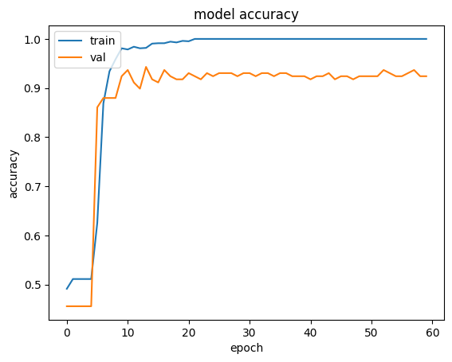
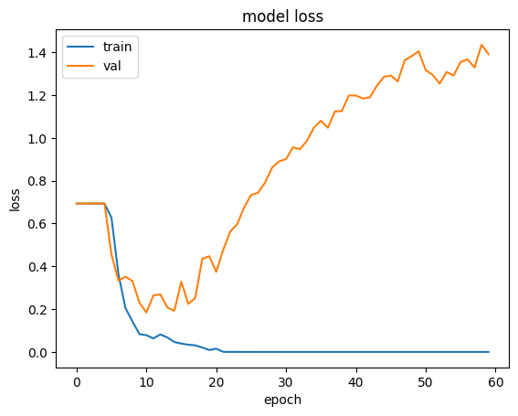
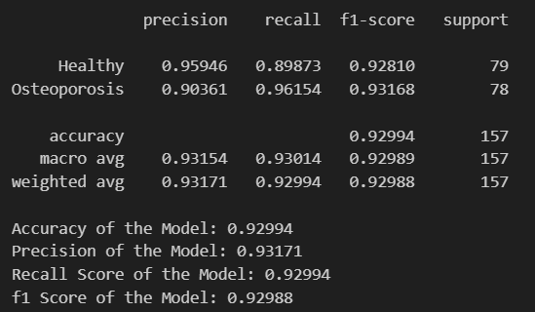

Slide 31


Slide 32
XceptionNet for Multiclass Model:
XceptionNet (Extreme Inception) is a deep convolutional neural network architecture that improves upon Inception by replacing its modules with depthwise separable convolutions. This modification reduces computational complexity while maintaining high accuracy, especially for image classification and recognition tasks. XceptionNet is widely recognized for its efficiency and strong performance on large-scale datasets, making it a powerful choice for deep learning applications.

Slide 33
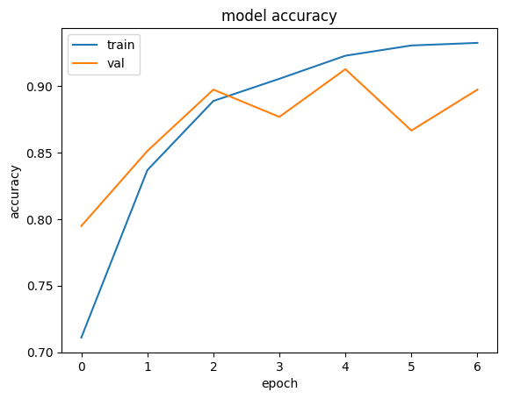
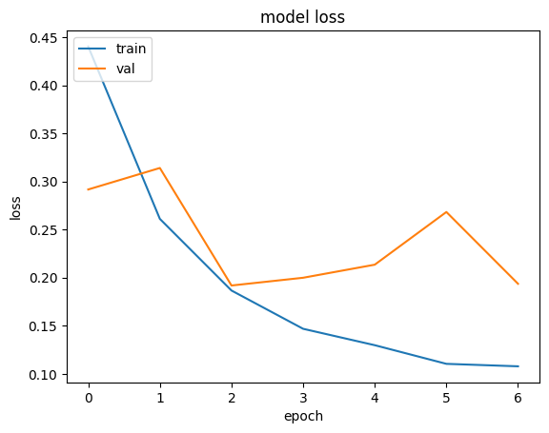
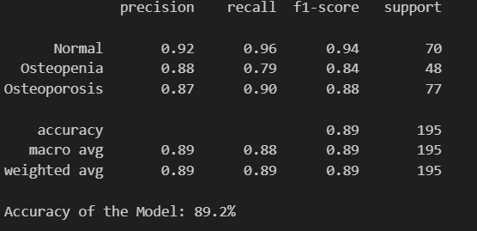

Slide 34
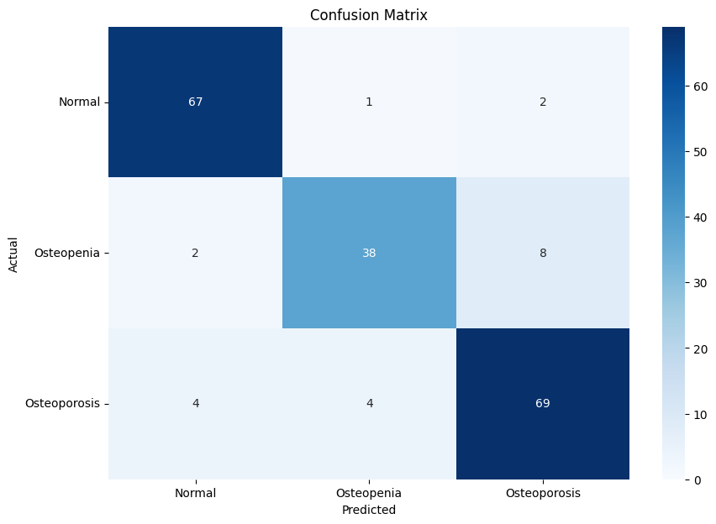

Slide 35
Proposed System (Hybrid Models)

Slide 36
VGG19 + InceptionResnetV2 + MobileNetV2
Architecture:
Feature Extraction: The input image is resized to a common dimension (e.g., 224×224 or 299×299) and fed into three separate pretrained models (VGG19, InceptionResNetV2, MobileNetV2) where, instead of their classification layers, feature maps are extracted from intermediate layers such as the Global Average Pooling (GAP) layer.
Feature Fusion: The feature vectors from the GAP layers of each model are concatenated to form a joint feature representation, enhancing generalization by combining the fine-grained spatial details from VGG19, multi-scale features from InceptionResNetV2, and efficient feature extraction from MobileNetV2.
Classification Layer: The fused feature vector is then passed through a fully connected layer with dropout applied to reduce overfitting, followed by a softmax layer that outputs the predicted class labels.

Slide 37
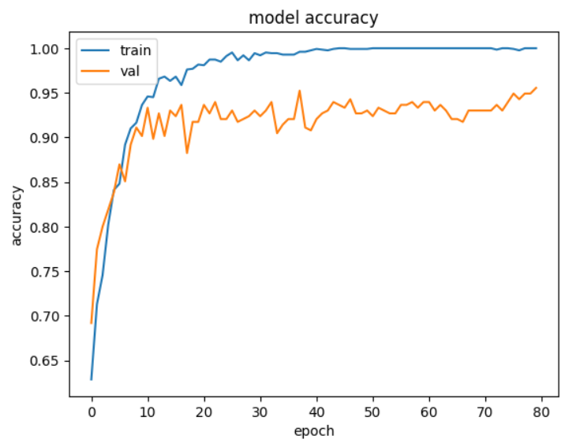
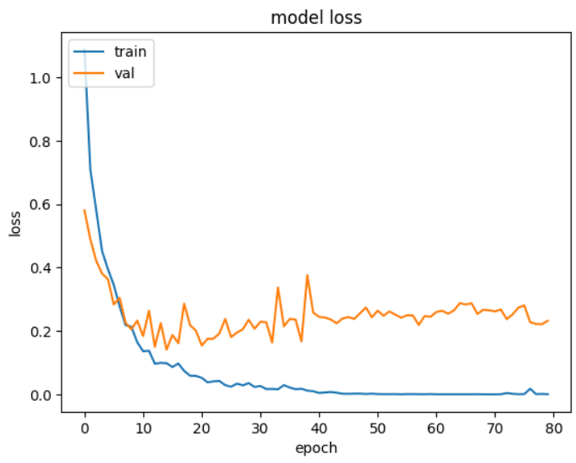

Slide 38
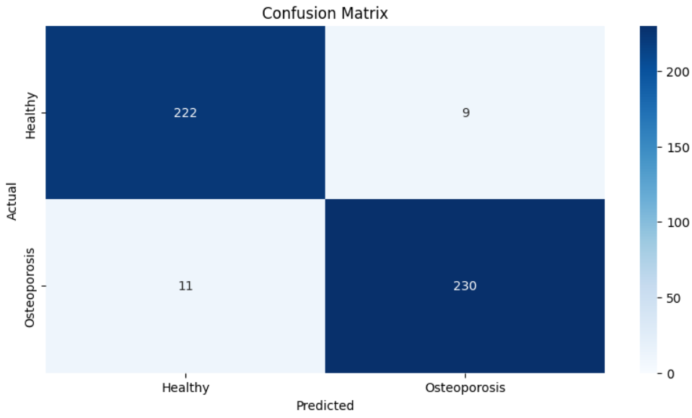
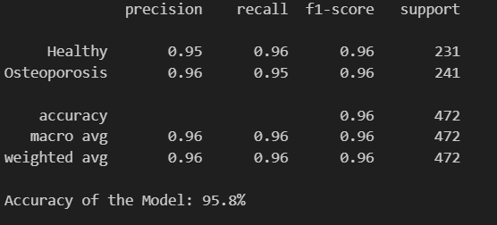

Slide 39
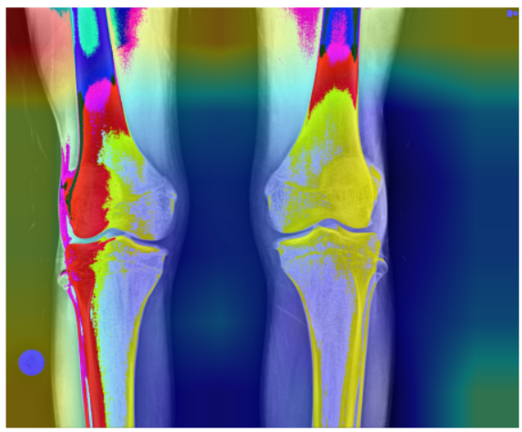
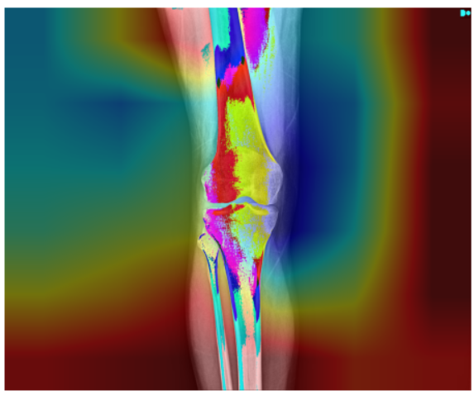
We have used Grad-CAM here to visualize which parts of the input image the model focused on when making its prediction
Red/Yellow Areas: These colors indicate high activation values. In other words, the model finds these regions very important for its prediction.
Green: Represents intermediate activation values.
Blue: Indicates low activation values, meaning these areas contributed less to the prediction.

Slide 40
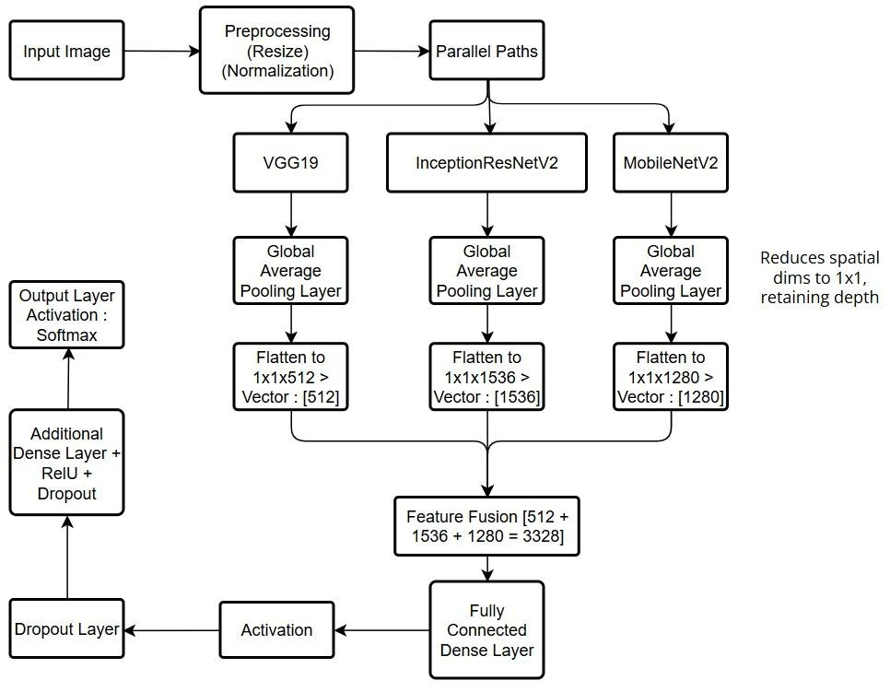
Model
Architecture

Slide 41
Why use this model?
Enhanced Feature Representation: By combining the deep hierarchical features of VGG19, the multi-scale capabilities of InceptionResNet, and the efficiency of MobileNetV2, the hybrid model captures a richer set of features.
Improved Accuracy: The diversity in feature extraction often results in better performance on complex datasets, as the model is more robust to variations in input data.
Generalization: The ensemble approach can help reduce overfitting by leveraging complementary strengths, thereby generalizing better to unseen data.
Flexibility in Deployment: Although one branch (MobileNetV2) is lightweight, the combination allows balancing performance and computational efficiency. For example, parts of the network could be selectively pruned or optimized based on deployment needs.

Slide 42
DenseNet + EfficientNet
Input Processing: The input image is uniformly resized and preprocessed (e.g., to 224×224) to meet the requirements of both DenseNet and EfficientNet.
Parallel Feature Extraction: In the DenseNet stream, the image is processed through dense blocks and features are extracted from the final pooling or an intermediate layer; simultaneously, the EfficientNet stream processes the same image and extracts features from its global average pooling layer.
Feature Fusion: The feature vectors from DenseNet and EfficientNet are concatenated to form a comprehensive representation, though alternative methods like element-wise summation or attention-based fusion can also be used.
Classification Layer: The combined feature vector is fed through one or more fully connected layers—with dropout applied to reduce overfitting—before the final softmax (or sigmoid) layer outputs the class probabilities.

Slide 43
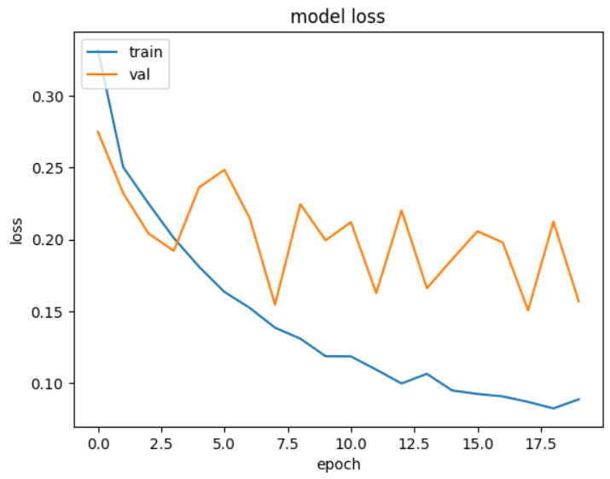
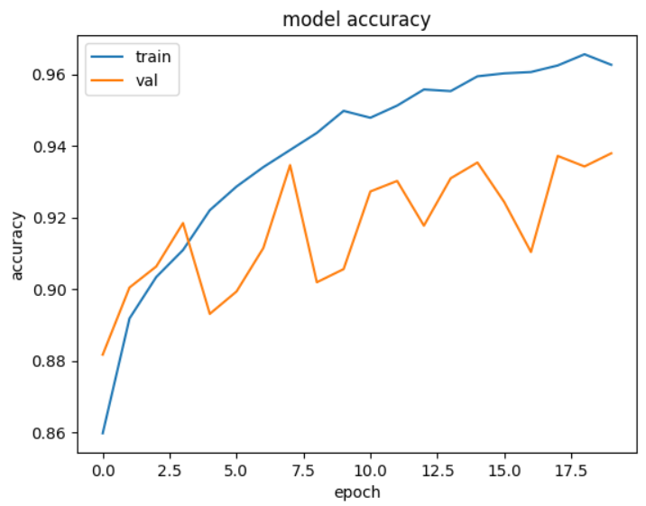

Slide 44
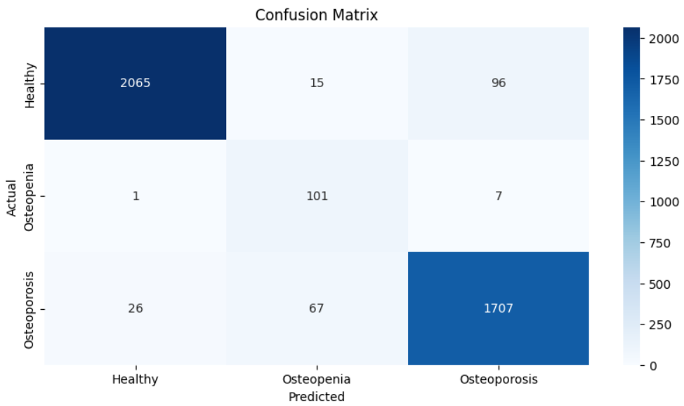
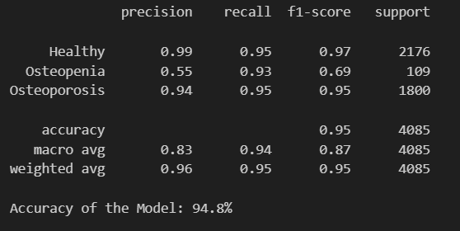

Slide 45
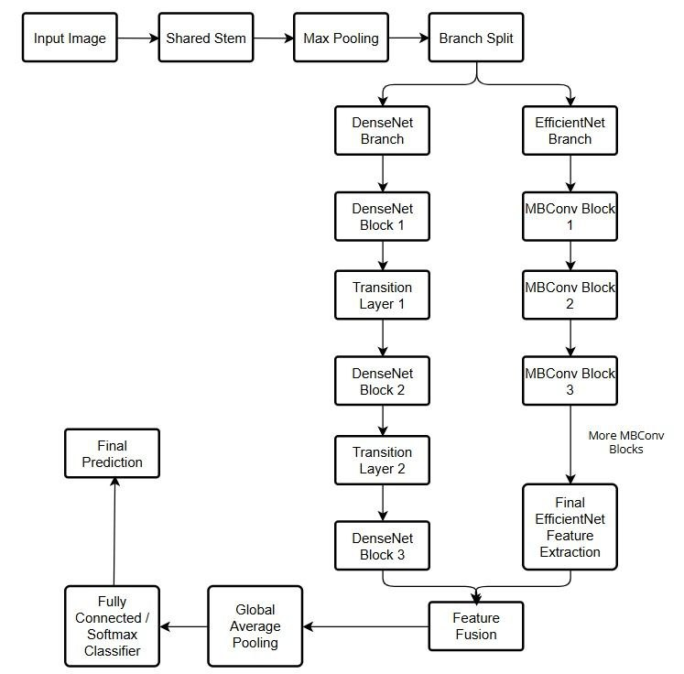
Model
Architecture

Slide 46
Why use this model?
EfficientNet Component:
Efficiency and Scalability: Quickly extracts primary features with minimal computation. Its scaling strategy ensures that the network can be adapted to various resource budgets.
Low-level to Mid-level Features: Captures basic visual patterns efficiently, laying a solid foundation for further feature refinement.
DenseNet Component:
Feature Reuse and Robust Gradient Flow: With its dense connectivity, it reuses features from multiple stages, ensuring that the network has access to both low-level and high-level information.
Enhanced Feature Fusion: The dense blocks help in integrating information across layers, which can lead to better overall representation and improved classification/regression performance.

Slide 47
Literature Review
KONet: Toward a Weighted Ensemble Learning Model for Knee Osteoporosis Classification - M. J. A. Rasool, S. Ahmad, U. Sabina and T. K. Whangbo
This paper presents a robust detection method called KONet, designed to address the challenges in identifying knee osteoporosis, a skeletal disorder characterized by bone tissue degradation and low bone density, which increases the risk of knee fractures. Traditional diagnostic methods like knee radiography often require specialist expertise, and the large volume of X-rays, coupled with subtle variations, can result in misinterpretation. Leveraging recent advancements in deep learning, particularly convolutional neural networks (CNNs), KONet employs a weighted ensemble approach to effectively distinguish between normal and osteoporotic knee conditions, even with minor data variations. Experimental results demonstrate that the proposed model achieves superior accuracy compared to existing methods, significantly outperforming state-of-the-art CNN-based models using transfer learning.
A new superfluity deep learning model for detecting knee osteoporosis and osteopenia in X-ray images - Naguib, S.M., Saleh, M.K., Hamza, H.M. et al
This study proposes a new deep-learning approach using a superfluity mechanism to categorize knee X-ray images into osteoporosis, osteopenia, and normal classes. The superfluity mechanism involves concatenating multiple layers, allowing features to flow into two branches. The proposed Superfluity DL model demonstrated the highest accuracy (85.42% for dataset1 and 79.39% for dataset2). Osteoporosis is a major public health problem, causing a reduction in bone mass and bone architecture disruption, increasing the risk of fracture and compromised bone strength. Early detection of osteoporosis/osteopenia using digital X-ray images would be useful and cost-effective in preventing fractures and other bone complexities. This study contributes to the development of a reliable, automated tool for initial assessment and reducing false positives and false negatives, enhancing the precision with which knee osteoporosis and osteopenia can be detected, allowing healthcare providers to prioritize patient care more effectively.

Slide 48
Detection of osteoporosis using image processing methods - Bo, Y., Chen, G., Li, L. et al.
This paper highlights osteoporosis as a silent, painless illness that increases bone fragility and fracture susceptibility across various areas, emphasizing the importance of early detection for prevention and treatment. While primary osteoporosis is more common in postmenopausal women and elderly men, the disease can affect individuals of any gender or age. Characterized by decreased bone mass, structural weakness, and increased fracture risk, its assessment often relies on bone density measurements, a key indicator for evaluating osteoporosis risk, though not equivalent to the physical density of bone. Diagnostic tools such as bone densitometry, MRI, and MRS provide insights into bone structure and marrow composition but are often costly and inaccessible. To address these challenges, computer-assisted diagnosis (CAD) methods—including image processing, intelligent neural network algorithms, and genetic algorithms—offer solutions for improving image analysis, speeding up diagnoses, and reducing costs and medical errors. These advancements aim to enhance diagnostic accuracy and efficiency while mitigating the limitations of traditional methods.
Comparative analysis of vision transformers and convolutional neural networks in osteoporosis detection from X-ray images - Sarmadi, A., Razavi, Z.S., van Wijnen, A.J. et al
This paper investigates the potential of the Vision Transformer (ViT) in medical image analysis, focusing on diagnosing osteoporosis using X-ray radio-images. Compared to traditional convolutional neural networks (CNNs), ViT demonstrates superior performance, highlighting its effectiveness when sufficient training data is available. The study underscores that both ViT and CNNs can offer robust solutions to critical medical diagnostic challenges. Deep learning, a subset of machine learning, leverages artificial neural networks (ANNs) to extract knowledge from extensive datasets and perform complex tasks. Its applications span diverse domains, including computer vision, natural language processing, speech recognition, recommender systems, autonomous vehicles, image generation, machine translation, game playing, and natural language understanding. Beyond these, deep learning is reshaping art, culture, and society by fostering innovation and creating new paradigms. In medical sciences, deep learning holds transformative potential, capable of handling large-scale and high-dimensional data while learning abstract and sophisticated functions, often with reduced dependence on extensive training datasets or predefined assumptions.

Slide 49
Application of a Neural Network Classifier to Radiofrequency-Based Osteopenia/Osteoporosis Screening - J. Adams, Z. Zhang, G. M. Noetscher, A. Nazarian and S. N. Makarov
This study introduces a neural network classifier to detect osteoporotic/osteopenic conditions using non-ionizing, very-low-power radiofrequency (RF) signals transmitted through the wrist. Data was collected from 67 participants divided into two groups: Group 1 included 27 osteoporotic/osteopenic individuals (DXA T-score < -1), and Group 2 included 40 healthy individuals without major fracture risk factors. RF spectra (30 kHz–2 GHz) were measured using dual antiphase patch antennas with controlled pressure. Input features included wrist circumference and the normalized transmission coefficient (S21N). A Multi-Layer Perceptron (MLP) neural network was implemented using MATLAB, and leave-one-out cross-validation was performed. Training utilized complex spectra, which combined magnitude and phase for 201 frequency points per wrist. Among tested methods, independently processing left and right wrist spectra, then combining results manually, yielded the best performance. The model achieved a sensitivity of 83% and specificity of 94%. This approach demonstrates potential for quick, cost-effective osteoporosis screening using small, portable devices.
Using machine learning techniques to predict the risk of osteoporosis based on nationwide chronic disease data - Tu, JB., Liao, WJ., Liu, WC. et al
This study developed a machine learning (ML) model to predict osteoporosis risk using chronic disease data from 10,000 patient records in the German Disease Analyzer database. Ten chronic conditions, including hypertension, diabetes, COPD, and cancer, were analyzed alongside demographic features like age and gender. Data was split into training (70%) and test (30%) sets using stratified random sampling, and class imbalance was addressed with oversampling. Recursive Feature Elimination (RFE) was used across nine ML algorithms to identify relevant predictors, retaining all eleven features for model development. A stacked ensemble model (Stacker) combining Logistic Regression, AdaBoost, and Gradient Boosting Classifier achieved the best performance. The Stacker model demonstrated superior accuracy, AUC-ROC (0.76), sensitivity (0.722), and specificity (0.664) compared to individual algorithms. SHAP analysis revealed the most influential features: age, gender, lipid metabolism disorders, cancer, and COPD. The model's reliability was validated using cross-validation, confusion matrix, calibration curves, and lift curves. The study underscores the potential of ML in early osteoporosis detection, enabling personalized management strategies. The findings provide a robust framework for leveraging chronic disease data to improve public health outcomes.
\

Slide 50
Osteoporosis Prediction Using Machine‑Learned Optical Bone Densitometry Data - Miura, K., Tanaka, S.M., Chotipanich, C. et al
The study investigates the classification of osteoporosis using a machine learning (ML) model based on bone mineral density (BMD) measurements obtained from dual-energy X-ray absorptiometry (DXA) scans. A total of 203 participants, including 182 patients and 21 hospital staff, underwent BMD assessments of the lumbar spine, femur, and forearm. The optical measurements were taken using a system comprising two convex lenses, annular slits, a photodetector, and a laser diode operating at 850 nm wavelength. The T-scores were calculated to classify participants into osteoporosis (T-score ≤ -2.5) and non-osteoporosis groups. The ML model's parameters were optimized through grid-search with fivefold cross-validation, aiming to minimize the root mean squared error (RMSE). The study also employed ROC analysis to determine the optimal cutoff value for T-scores using Youden's index. Statistical analyses included Student's t-test and Pearson's chi-square test to compare group characteristics. The findings contribute to improving osteoporosis discrimination performance through advanced optical measurement techniques and machine learning methodologies.
Revolutionizing Osteoporosis and Bone Fracture Diagnostics: The Emergence of Microwave Antenna Technology - Miura, K., Tanaka, S.M., Chotipanich, C. et al
Osteoporosis, a condition marked by reduced bone density and weakened bone structure, poses a significant health challenge, especially among the elderly, often resulting in fractures and hospitalizations. While established diagnostic tools like DEXA, MRI, QCT, and QUS are widely used, microwave sensing is emerging as a promising alternative. Its non-invasive nature, affordability, and accuracy make it an attractive option for early detection of osteoporosis and fractures. Recent advancements in microwave sensing focus on improved measurement techniques and innovative antenna designs, offering a practical and reliable approach for identifying bone changes and enabling earlier, more effective patient care.

Slide 51
The clinical use of quantitative ultrasound (QUS) in the detection and management of osteoporosis - D. Hans and M. -a. Krieg
Quantitative ultrasound (QUS) is emerging as an affordable and accessible alternative to dual-energy X-ray absorptiometry (DXA) for evaluating bone mineral density (BMD) in specific situations. This review explores the use of QUS in six areas: assessing fracture risk, diagnosing osteoporosis, initiating and monitoring treatment, identifying cases, and ensuring quality control. Heel QUS, the most studied device, has proven effective for fracture risk assessment, particularly in Caucasian women over 55. While some QUS devices show moderate accuracy in diagnosing osteoporosis, their role in guiding and monitoring treatment remains limited. A practical protocol combining clinical risk factors with heel QUS is suggested for identifying high-risk individuals.
Detection and Monitoring of Osteoporosis in a Rat Model by Thermoacoustic Tomography - Z. Chi, X. Liang, X. Wang, L. Huang and H. Jiang
Osteoporosis, a condition marked by reduced bone mineral density (BMD) and poor bone quality, poses a significant health challenge. This study explores the use of thermoacoustic tomography (TAT) as a noninvasive method to detect and monitor osteoporosis over time. Researchers used a rat model, where osteoporosis was induced in four rats through bilateral ovariectomy, while sham-operated rats served as controls. The right tibia of each rat was imaged with TAT at five intervals over 100 days, and the findings were validated using micro-computed tomography (Micro-CT). In sham-operated rats, thermoacoustic signal intensities steadily increased, reflecting normal bone growth, while osteoporotic rats showed fluctuating signals, indicating abnormal bone changes. These results reveal clear differences between healthy and osteoporotic bone, demonstrating TAT's ability to detect osteoporosis. The study highlights TAT as a promising tool for noninvasive, early detection and long-term monitoring of osteoporosis, with potential clinical applications in managing this condition.

Slide 52
A diagnostic approach integrated multimodal radiomics with machine learning models based on lumbar spine CT and X‑ray for osteoporosis - Cheng, L., Cai, F., Xu, M. et al.
The paper discusses a study on predicting bone density using radiomics features extracted from medical imaging. It involved retrieving image data from picture archiving and communication systems and clinical data from hospital information systems. Two radiologists performed manual segmentation of the regions of interest (ROI) using 3D slicer and ITK-SNAP software. Radiomic features were extracted using Python and the pyradiomics library, focusing on various matrices and shape-based features. Dimensionality reduction was achieved through intraclass correlation coefficient analysis, z-score transformation, and the minimum redundancy maximum relevance algorithm. The final model combined selected radiomics features with clinical risk factors, evaluated using logistic regression, support vector machine, and random forest algorithms. Performance metrics included AUC, accuracy, sensitivity, specificity, and predictive values. The study concluded that the combined model effectively predicts bone quality, demonstrating its potential for clinical application in osteoporosis screening.
Interpretable Deep-Learning Approaches for Osteoporosis Risk Screening and Individualized Feature Analysis Using Large Population-Based Data: Model Development and Performance Evaluation - Suh B, Yu H, Kim H, Lee S, Kong S, Kim JW, Choi J
The paper discusses the development and evaluation of deep learning (DL) models for predicting bone mineral density (BMD) using data from the Korean Health and Nutrition Examination Survey (KNHANES) and the National Health and Nutrition Examination Survey (NHANES). The authors implemented a DL algorithm consisting of three layers, including two dense layers with rectified linear unit activation functions and a final softmax layer. They optimized hyperparameters through five-fold cross-validation, achieving different configurations for NHANES and KNHANES datasets. The NHANES model had dense layers with 128 and 16 nodes for femoral neck BMD, while the KNHANES model had 128 and 32 nodes for total femur BMD. Both models utilized dropout rates and the Adam optimizer with a learning rate of 0.005. The results indicated that the DL models performed effectively in predicting BMD, demonstrating the potential of machine learning techniques in health data analysis.

Slide 53
Deep ensemble learning for osteoporosis diagnosis from knee X-rays: a preliminary cohort study in Kashmir valley - Wani, I.M., Arora, S. Deep
The paper discusses a study conducted on bone mineral density (BMD) among participants in Kashmir, where data was collected from a 10-day BMD camp involving 932 individuals. Out of these, 240 participants underwent knee X-rays, and their data included questionnaires and QUS system diagnoses. The study utilized a custom dataset comprising X-ray images and clinical data to enhance osteoporosis diagnosis. Two neural network models were employed: Convolutional Neural Networks (CNN) for image data and Deep Neural Networks (DNN) for clinical data. Models like VggNet-16, VggNet-19, AlexNet, Dense-Net and ResNet-18 are trained with image data. The best classification accuracies achieved by CNNs for image sets are 91.1% achieved by AlexNet and 87% by ResNet-18. The best accuracy achieved by DNN is 95.8. The integration of clinical data with imaging data improved diagnostic accuracy. The proposed ensemble model effectively combined the strengths of both CNN and DNN, leading to better performance in osteoporosis detection. The study highlights the importance of using lower radiation exposure methods for imaging in medical diagnostics.
Application of deep learning model based on unenhanced chest CT for opportunistic screening of osteoporosis: a multicenter retrospective cohort study - Huang, C., Wu, D., Wang, B. et al.
The study investigates the use of skeletal muscle index (SMI) as a predictor for osteoporosis and fracture risk in individuals with degenerative spinal disease. It involved 1126 participants across four institutions, with data analyzed using statistical methods such as the Student's t-test and Pearson Chi-square test. Five convolutional neural network (CNN) models (Densent121, Inception_v3, Googlenet, Resnet50, and VGG16) were constructed using cropped CT images of the T12 vertebrae, focusing on regions of interest (ROI). The models were pre-trained on the ImageNet dataset and trained over 200 epochs with a stochastic gradient descent optimizer. The SMI was calculated by dividing the skeletal muscle area by the square of the patient's height. Results indicated significant differences in age, BMI, and SMI between patients with and without osteoporosis across all institutions. The study concluded that SMI could effectively predict osteoporosis risk, highlighting its potential clinical utility.

Slide 54
Evaluation of deep learning‑based quantitative computed tomography for opportunistic osteoporosis screening - Oh, S., Kang, W.Y., Park, H. et al.
The study presents a new deep learning (DL) algorithm aimed at automating vertebral segmentation and localizing the L1 and L2 vertebrae in routine clinical CT scans. The methodology involved using a U-Net network architecture with encoder and decoder modules, incorporating various image pre-processing techniques such as window level adjustments and data augmentation to enhance model performance. The algorithm was trained on paired spinal mask data to accurately draw regions of interest (ROIs) for calculating volumetric bone mineral density (BMD). Results indicated that the DL-based automated QCT BMD measurement could effectively screen for osteoporosis, with patient classification into osteoporosis, osteopenia, and normal groups based on central DXA values. The study found that 66.7% of patients fell into the low-BMD category, highlighting the potential of this method to improve osteoporosis detection without relying solely on DXA scans.

Slide 55
References
M. J. A. Rasool, S. Ahmad, U. Sabina and T. K. Whangbo, "KONet: Toward a Weighted Ensemble Learning Model for Knee Osteoporosis Classification," in IEEE Access, vol. 12, pp. 5731-5742, 2024, doi: 10.1109/ACCESS.2023.3348817.
Naguib, S.M., Saleh, M.K., Hamza, H.M. et al. A new superfluity deep learning model for detecting knee osteoporosis and osteopenia in X-ray images. Sci Rep 14, 25434 (2024). https://doi-org.egateway.chennai.vit.ac.in/10.1038/s41598-024-75549-0
Bo, Y., Chen, G., Li, L. et al. Detection of osteoporosis using image processing methods. J Opt 53, 2898–2908 (2024). https://doi-org.egateway.chennai.vit.ac.in/10.1007/s12596-023-01517-y
Sarmadi, A., Razavi, Z.S., van Wijnen, A.J. et al. Comparative analysis of vision transformers and convolutional neural networks in osteoporosis detection from X-ray images. Sci Rep 14, 18007 (2024). https://doi-org.egateway.chennai.vit.ac.in/10.1038/s41598-024-69119-7
J. Adams, Z. Zhang, G. M. Noetscher, A. Nazarian and S. N. Makarov, "Application of a Neural Network Classifier to Radiofrequency-Based Osteopenia/Osteoporosis Screening," 2021 43rd Annual International Conference of the IEEE Engineering in Medicine & Biology Society (EMBC), Mexico, 2021, pp. 15-18, doi: 10.1109/EMBC46164.2021.9630944.

Slide 56
Tu, JB., Liao, WJ., Liu, WC. et al. Using machine learning techniques to predict the risk of osteoporosis based on nationwide chronic disease data. Sci Rep 14, 5245 (2024). https://doi-org.egateway.chennai.vit.ac.in/10.1038/s41598-024-56114-1
Miura, K., Tanaka, S.M., Chotipanich, C. et al. Osteoporosis Prediction Using Machine-Learned Optical Bone Densitometry Data. Ann Biomed Eng 52, 396–405 (2024). https://doi-org.egateway.chennai.vit.ac.in/10.1007/s10439-023-03387-8
@ARTICLE{10737345, author={Shakhawat Hossen, Md and Tariqul Islam, Mohammad and Hoque, Ahasanul and Alenezi, Abdulmajeed M. and Kirawanich, Phumin and Hafiz Baharuddin, Mohd and Faouri, Yanal S. and Arafatur Rahman, Md}, journal={IEEE Access}, title={Revolutionizing Osteoporosis and Bone Fracture Diagnostics: The Emergence of Microwave Antenna Technology}, year={2024}, volume={12}, number={}, pages={160418-160440}, keywords={Bones;Osteoporosis;Microwave theory and techniques;Microwave imaging;Sensors;Microwave antennas;Microwave measurement;Dielectrics;Costs;X-ray imaging;Bone mineral density;osteoporosis detection;biomedical antenna;bone fracture diagnosis;microwave antenna;microwave machine learning}, doi={10.1109/ACCESS.2024.3487858}}
D. Hans and M. -a. Krieg, "The clinical use of quantitative ultrasound (QUS) in the detection and management of osteoporosis," in IEEE Transactions on Ultrasonics, Ferroelectrics, and Frequency Control, vol. 55, no. 7, pp. 1529-1538, July 2008, doi: 10.1109/TUFFC.2008.829.

Slide 57
Z. Chi, X. Liang, X. Wang, L. Huang and H. Jiang, "Detection and Monitoring of Osteoporosis in a Rat Model by Thermoacoustic Tomography," in IEEE Journal of Electromagnetics, RF and Microwaves in Medicine and Biology, vol. 4, no. 4, pp. 234-239, Dec. 2020, doi: 10.1109/JERM.2020.2964152
Cheng, L., Cai, F., Xu, M. et al. A diagnostic approach integrated multimodal radiomics with machine learning models based on lumbar spine CT and X-ray for osteoporosis. J Bone Miner Metab 41, 877–889 (2023). https://doi.org/10.1007/s00774-023-01469-0
Suh B, Yu H, Kim H, Lee S, Kong S, Kim J, Choi J
Interpretable Deep-Learning Approaches for Osteoporosis Risk Screening and Individualized Feature Analysis Using Large Population-Based Data: Model Development and Performance Evaluation
J Med Internet Res 2023;25:e40179
URL: https://www.jmir.org/2023/1/e40179
DOI: 10.2196/40179
Wani, I.M., Arora, S. Deep ensemble learning for osteoporosis diagnosis from knee X-rays: a preliminary cohort study in Kashmir valley. Neural Comput & Applic 36, 21041–21059 (2024). https://doi.org/10.1007/s00521-024-10158-6
Huang, C., Wu, D., Wang, B. et al. Application of deep learning model based on unenhanced chest CT for opportunistic screening of osteoporosis: a multicenter retrospective cohort study. Insights Imaging 16, 10 (2025). https://doi.org/10.1186/s13244-024-01817-2
Oh, S., Kang, W.Y., Park, H. et al. Evaluation of deep learning-based quantitative computed tomography for opportunistic osteoporosis screening. Sci Rep 14, 363 (2024). https://doi.org/10.1038/s41598-023-45824-7

Slide 58
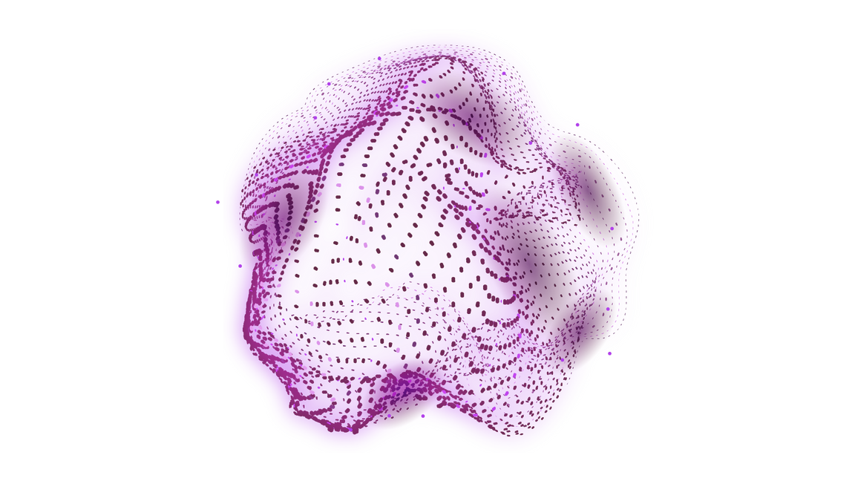
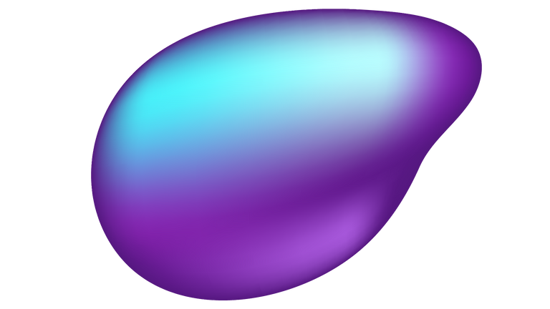
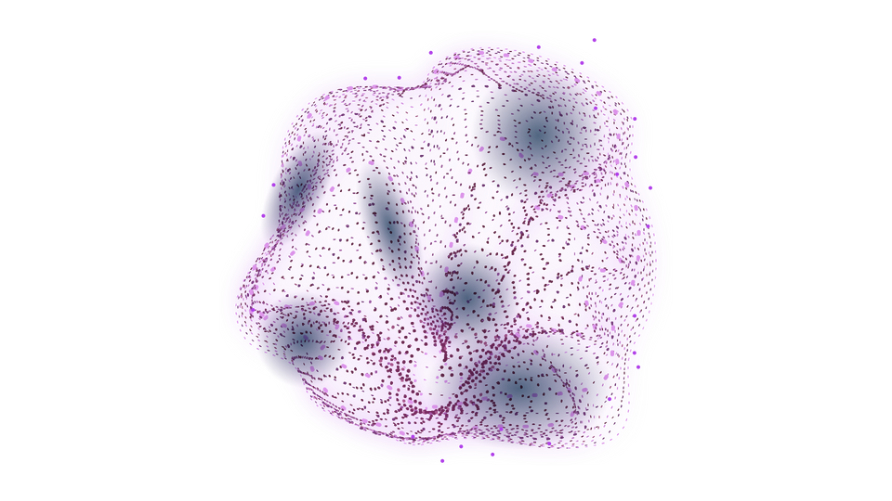
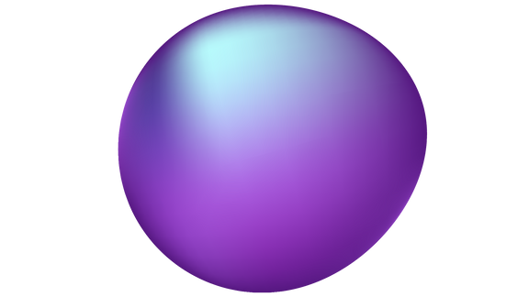
THANK YOU!

